Slide 1
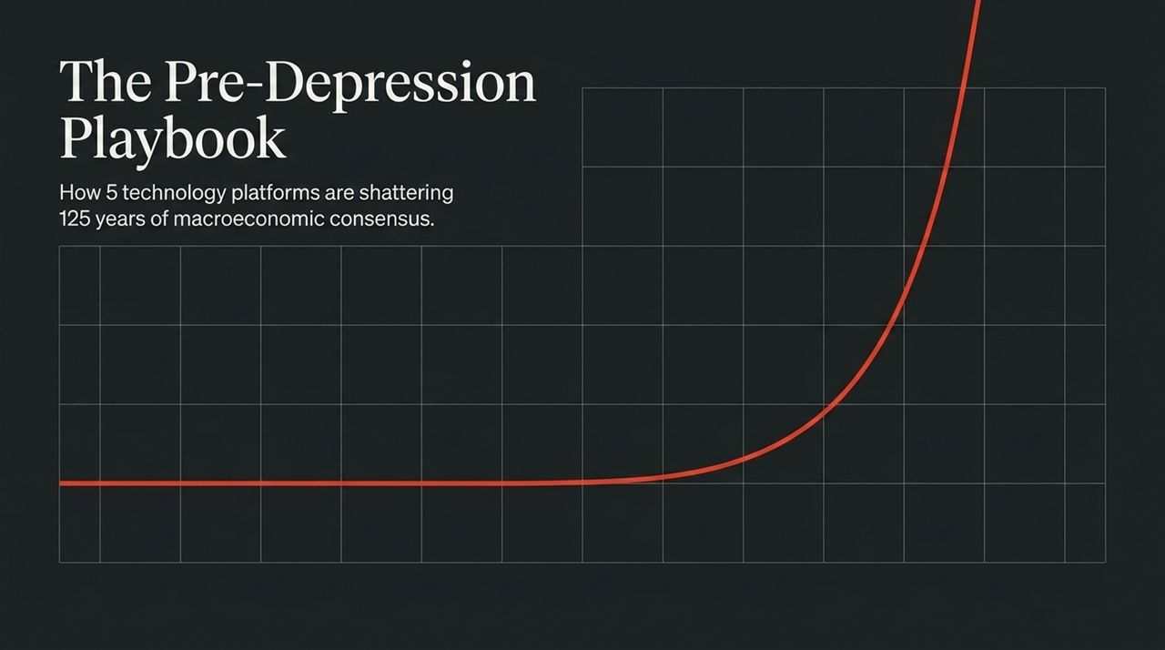
Notes:
Welcome everyone. Today, we are taking a step back to look at macroeconomics through a multi-decade and multi-century lens.
The title of this deck, "The Pre-Depression Playbook," highlights a critical historical comparison: we are experiencing structural economic shifts that haven't occurred since prior to the Great Depression.
Five convergent technology platforms—Artificial Intelligence, Robotics, Energy Storage, Blockchain, and Multiomics—are disrupting over 125 years of macroeconomic consensus.
Most financial models today assume legacy parameters. However, as we will demonstrate, modern technology is re-writing the rules around GDP growth, inflation, yield curves, and market valuations.
https://www.youtube.com/watch?v=bjgy0BVFQx0

Slide 2
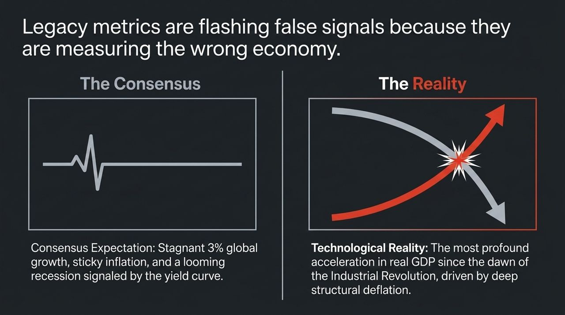
Notes:
Market consensus remains stuck in legacy frameworks: expecting ~3% global growth, persistent inflation, and taking an inverted yield curve as a sign of an impending recession.
The Reality: We are entering the most significant acceleration in real GDP since the dawn of the Industrial Revolution.
Rather than sticky inflation, the underlying macroeconomic force driven by these technologies is deep structural deflation.
Wall Street and legacy models treat traditional signals (like rate hikes or yield curve inversions) with fear. In reality, the market resilience we see today is driven by explosive real economic growth potential, not out-of-control inflation.

Slide 3
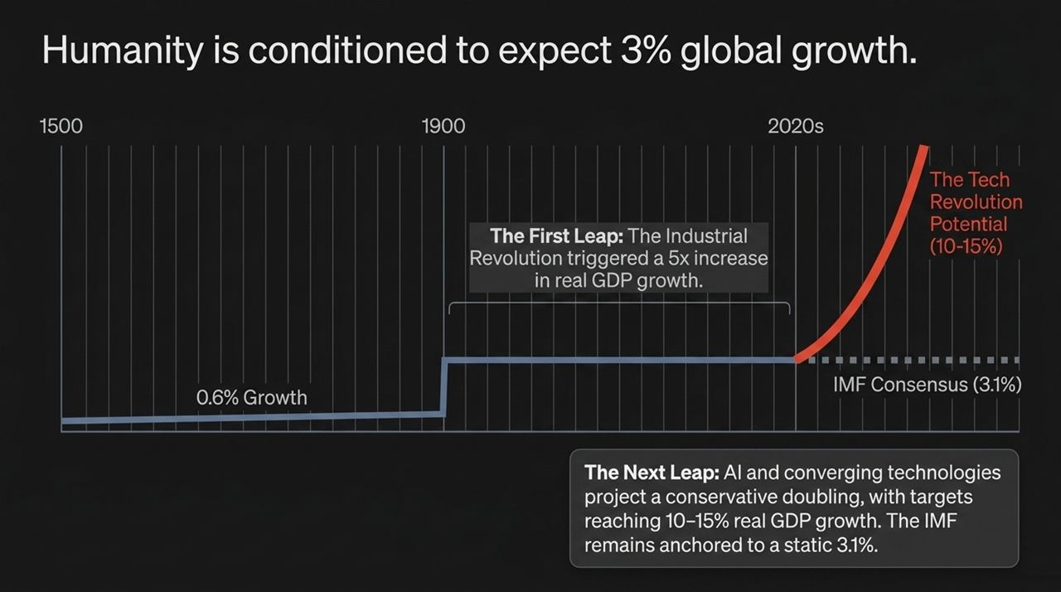
Notes:
Prior to 1500–1900, world GDP growth averaged just 0.6%.
The Industrial Revolution represented the "First Leap," causing a 5x increase in real GDP growth to a sustained ~3.1% annually.
For the last 125 years, humanity has been conditioned to treat 3% global GDP growth as the default ceiling. Organizations like the IMF continue to project a static 3.1% growth.
The Next Leap: With AI and converging platforms, growth is projected to conservatively double, with potential targets reaching 10% to 15% real GDP growth.
Tech leaders (like Elon Musk) and forward-thinking analysts recognize that five simultaneous innovation platforms will drive productivity far beyond historical consensus.

Slide 4
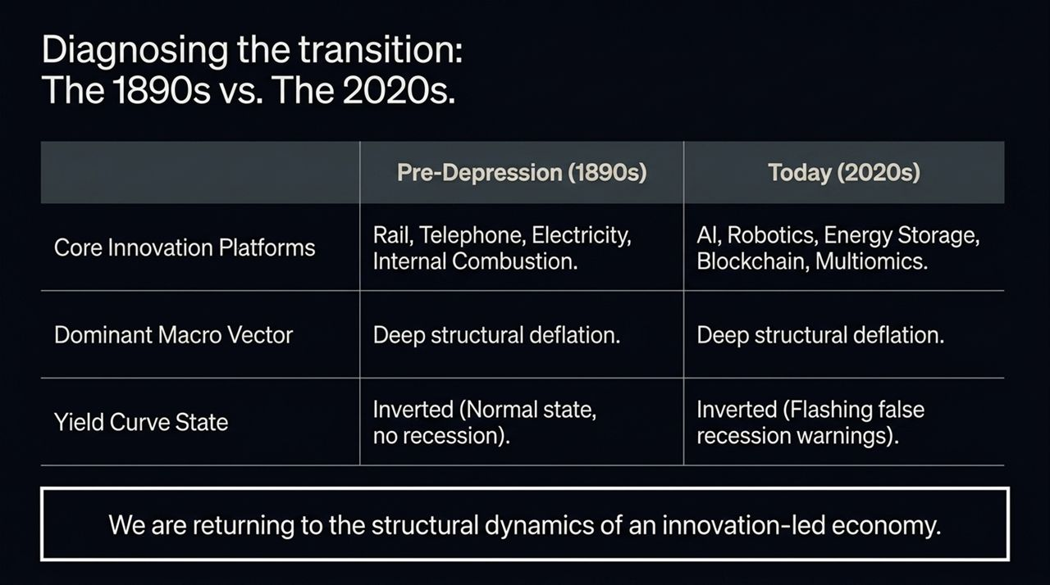
Notes:
To understand today, we have to look back to the late 19th century (1890s).
1890s Innovation: Rail, Telephone, Electricity, Internal Combustion Engine.
2020s Innovation: AI, Robotics, Energy Storage, Blockchain, Multiomics.
The Common Vector: Deep structural deflation. Rapid technological progress lowers unit costs across production, logistics, and communication.
Yield Curves: In the late 1800s, inverted yield curves were a normal state during periods of immense real economic growth and technological deflation. Today's inverted curve is flashing false recession warnings because legacy models misinterpret this setup.

Slide 5
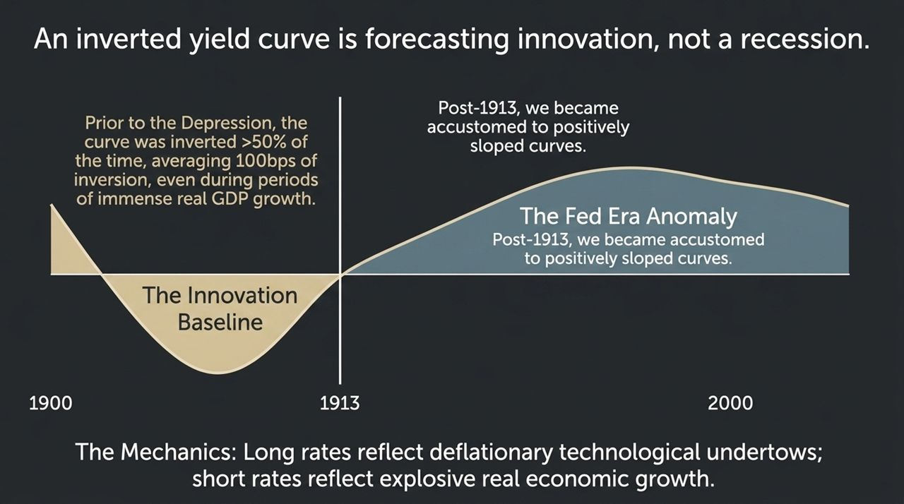
Notes:
The Fed Era Anomaly: Post-1913 (after the establishment of the Federal Reserve) and post-Depression, markets became accustomed to positively sloped yield curves as the baseline.
Prior to 1913, during the height of the Industrial Revolution, the yield curve was inverted more than 50% of the time (averaging ~100 bps inversion) without signifying a recession.
The Mechanics:
Long Rates: Reflect long-term deflationary technological undertows (costs falling over time).
Short Rates: Reflect high demand for capital and strong short-term real GDP expansion.
The current inversion is not signaling an imminent economic collapse; it reflects an innovation-led structural transition.

Slide 6
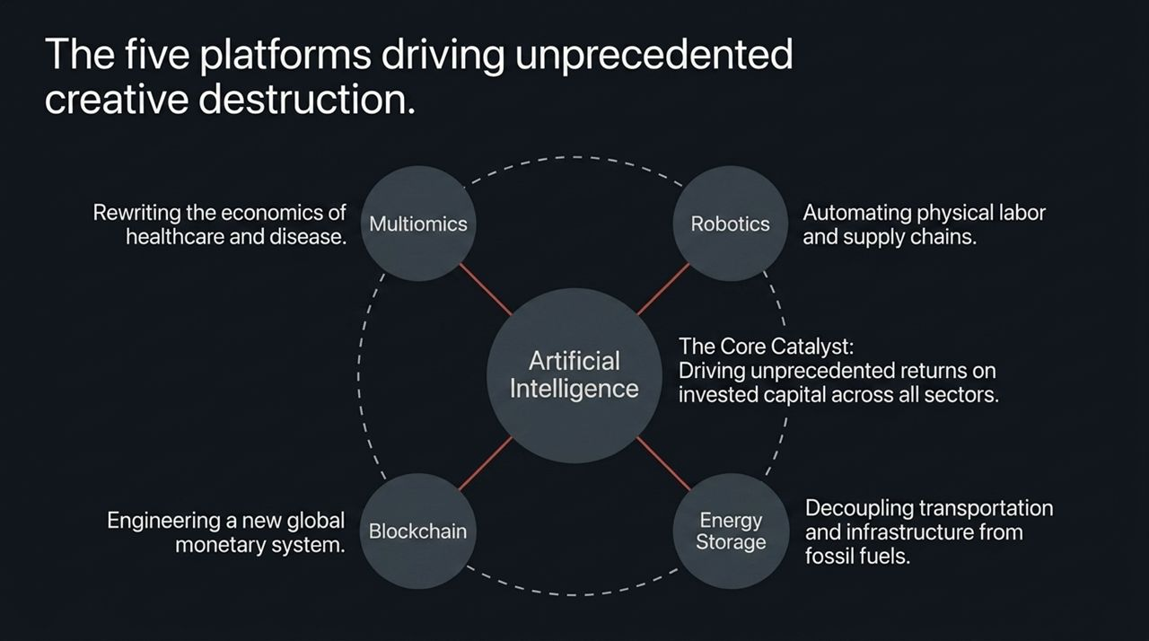
Notes:
While the Industrial Revolution was propelled by 3 main platforms (Rail, Electricity, Telephone), today's transformation is driven by 5 converging technology platforms:
Artificial Intelligence: The core catalyst driving unprecedented returns on invested capital (ROIC) across all sectors.
Robotics: Automating physical labor and transforming global supply chains.
Energy Storage: Decoupling transportation and grid power from fossil fuels.
Blockchain: Re-engineering global monetary systems and financial counterparty frameworks.
Multiomics: Rewriting healthcare, biological processing, and disease elimination economics.

Slide 7
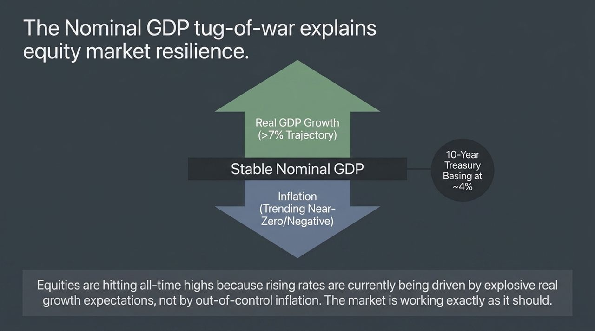
Notes:
Investors often ask: Why are equities reaching all-time highs despite rising interest rates?
Nominal GDP Formula: $\text{Nominal} \text{GDP}=\text{Real} \text{GDP} \text{Growth}+\text{Inflation}$.
There is an active macroeconomic tug-of-war:
Upward Force: Accelerating Real GDP growth (>7% trajectory).
Downward Force: Structural inflation trending near zero or turning negative due to technology cost drops.
Result: Nominal GDP remains healthy and stable, with 10-Year Treasury yields basing around 4%.
Equities are performing well because interest rates are anchoring around real economic performance and earnings expectations, not galloping inflation.

Slide 8
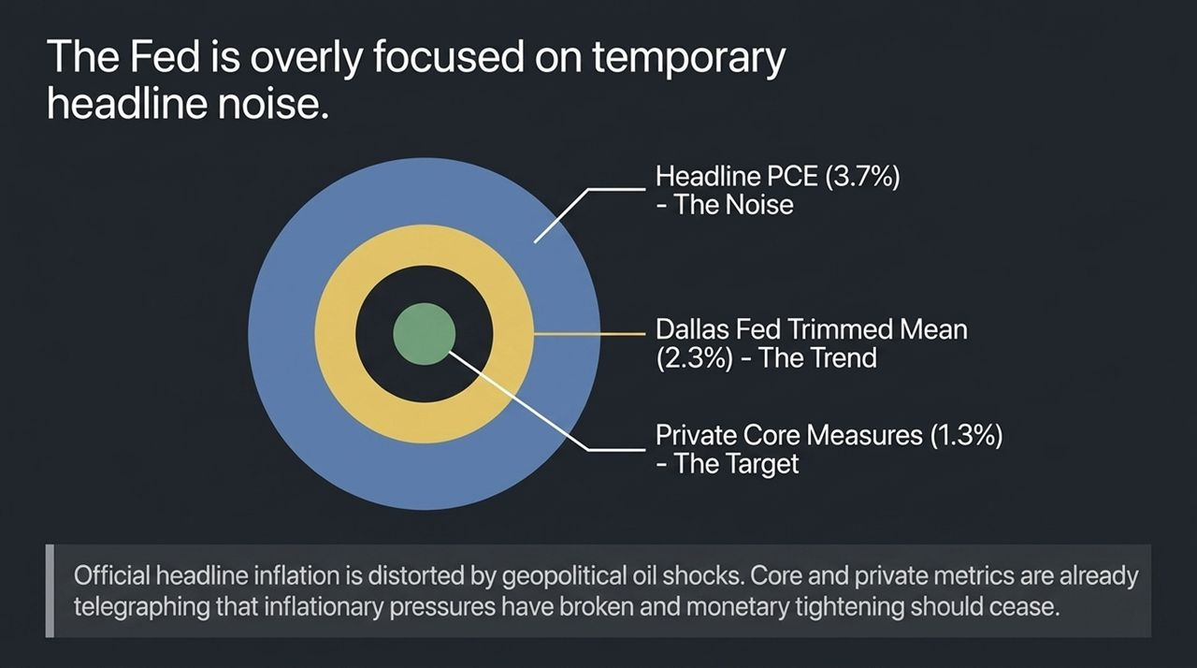
Notes:
Central banks are caught up in noisy, backward-looking headline metrics.
Headline PCE (~3.7%): Distorted heavily by temporary geopolitical energy/oil shocks.
Dallas Fed Trimmed Mean (~2.3%): Removes extreme price tail movements and shows the underlying cooling trend.
Private Core Measures (~1.3%): Direct market/private data show inflation is already well below the Fed's 2% target.
Key Insight: Policy tightening based solely on headline noise risks over-tightening into an economy that is structurally deflating.

Slide 9
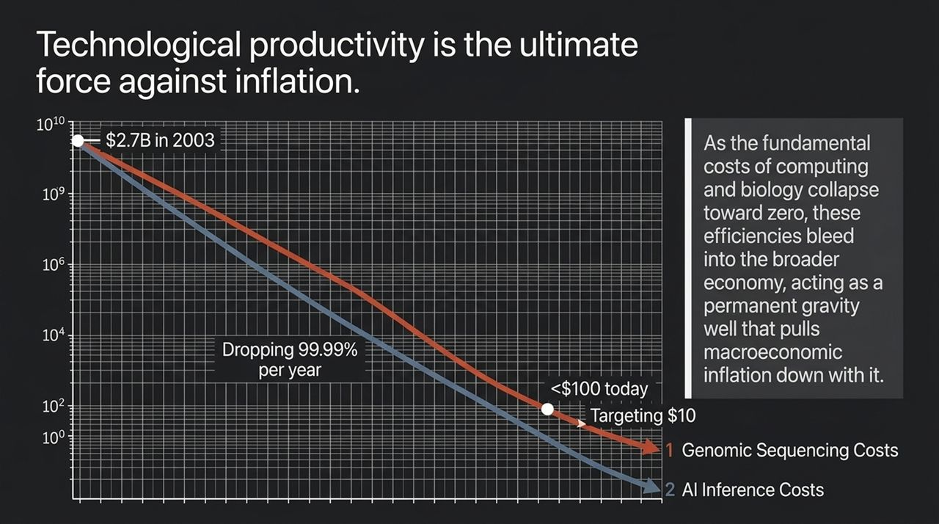
Notes:
Technological unit cost declines create an irreversible gravity well pulling macro inflation down.
Genomic Sequencing: Cost dropped from $2.7 Billion per genome in 2003 to under $100 today, targeting $10.
AI Inference: Costs are dropping at an astounding rate of 99.99% per year.
As compute and biological engineering costs collapse, these cost savings cascade into logistics, healthcare, software, and industrial production, crushing legacy inflationary pressures.

Slide 10
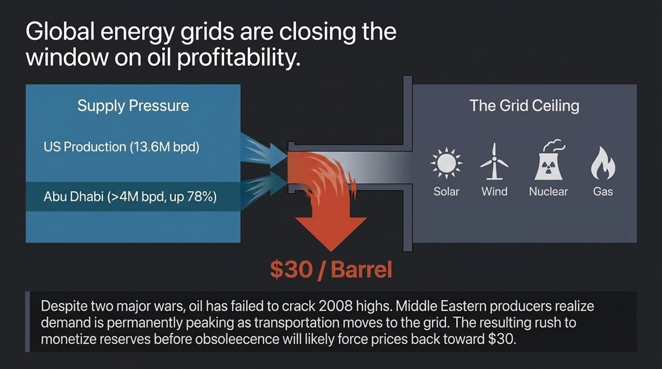
Notes:
Despite two active geopolitical conflicts, crude oil has failed to sustain or break its 2008 high ($147).
Supply Side Pressure: US production is at record levels (~13.6M bpd), Abu Dhabi output is up 78% (>4M bpd) after leaving OPEC constraints, and additional non-OPEC supply continues to expand.
Demand/Grid Ceiling: Transport is shifting to electricity. Grids are powered by solar, wind, nuclear, and natural gas—not crude oil.
Major Middle Eastern producers recognize oil demand is peaking. To prevent stranded assets, producers are rushing to monetize reserves before irrelevance, which could push crude prices down toward $30/barrel.

Slide 11
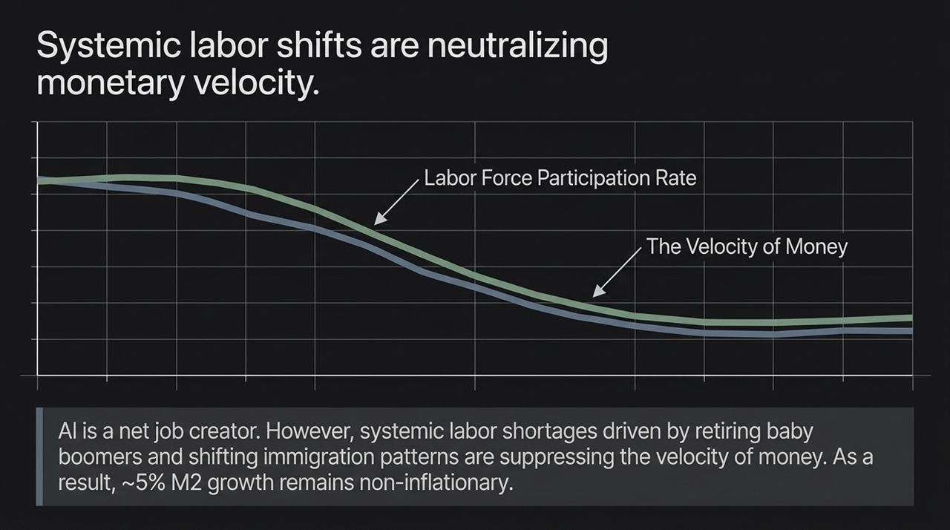
Notes:
Contrary to fears that AI destroys total employment, history and recent enterprise data show AI is a net job creator for innovative firms.
However, macro demographics—specifically retiring Baby Boomers and changing labor participation patterns—are structurally lowering the Velocity of Money ($V$).
Macro Impact: Because money velocity continues to decline/flatten alongside labor participation shifts, money supply growth (M2 around ~5%) remains non-inflationary.

Slide 12
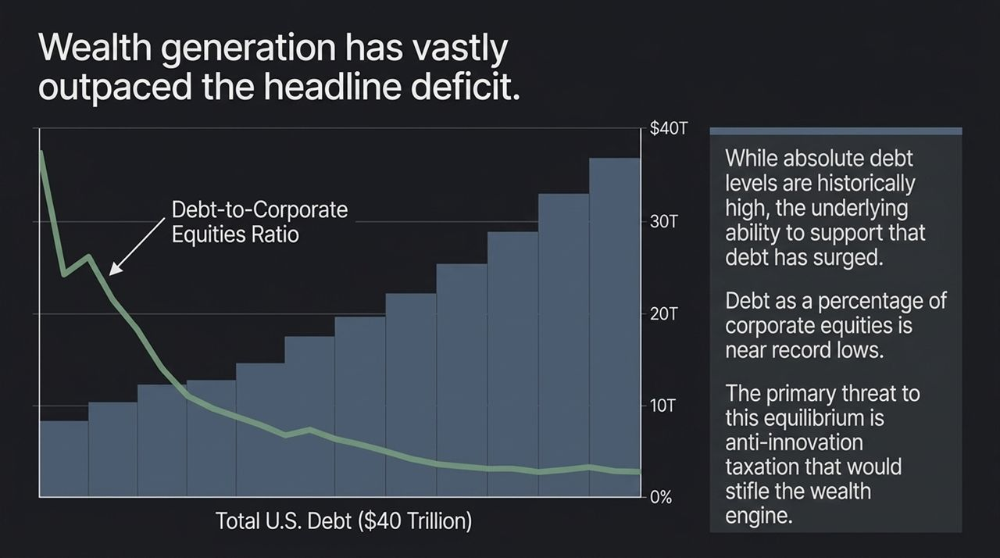
Notes:
Headlines constantly warn about the growing US national debt reaching ~$40 Trillion.
While absolute national debt is high relative to GDP, the Debt-to-Corporate Equities Ratio tells a completely different story.
Debt as a percentage of overall corporate equity wealth is sitting near record lows.
Technological expansion has generated massive equity wealth, dramatically enhancing the economy's capacity to service debt.
The Real Threat: Anti-innovation taxation or punitive wealth taxes that would choke the underlying technology wealth-generation engine

Slide 13
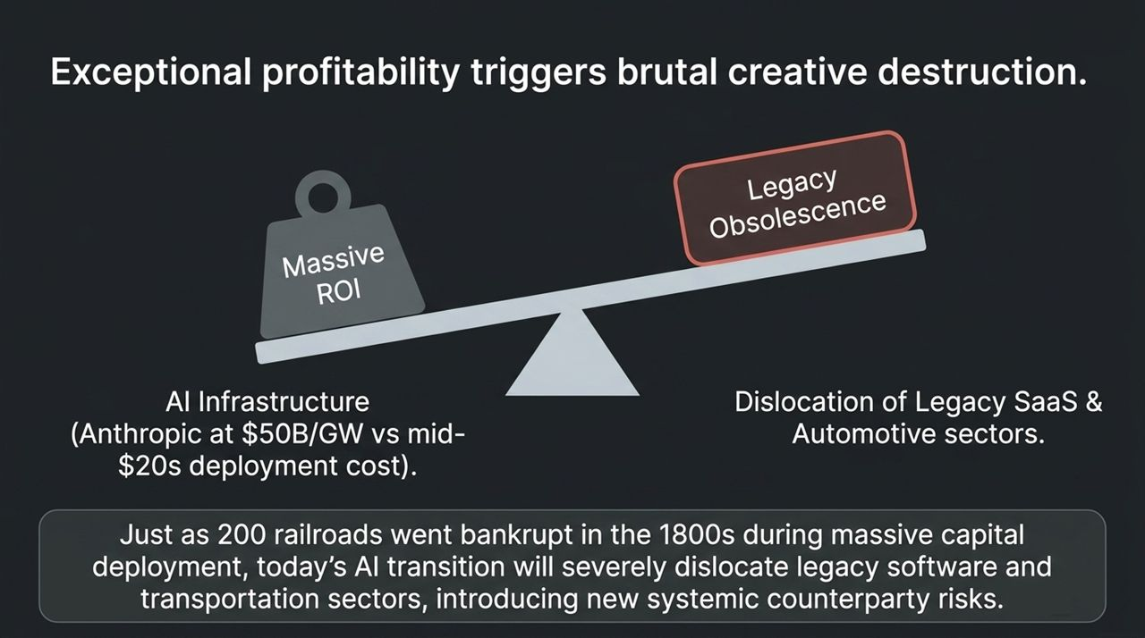
Notes:
High returns on invested capital (ROIC) always spark creative destruction.
Massive ROI: Look at modern AI infrastructure buildouts—e.g., compute commitments reaching $50B/GW versus mid-$20s deployment costs, creating immediate operational ROI.
Legacy Obsolescence: During the 19th century rail boom, 200 railroad companies went bankrupt while building out infrastructure.
Today's AI revolution will severely disrupt legacy Software-as-a-Service (SaaS) and traditional internal combustion automotive models.
Investors must navigate systemic counterparty risk as traditional cash-cow models face technological replacement.

Slide 14
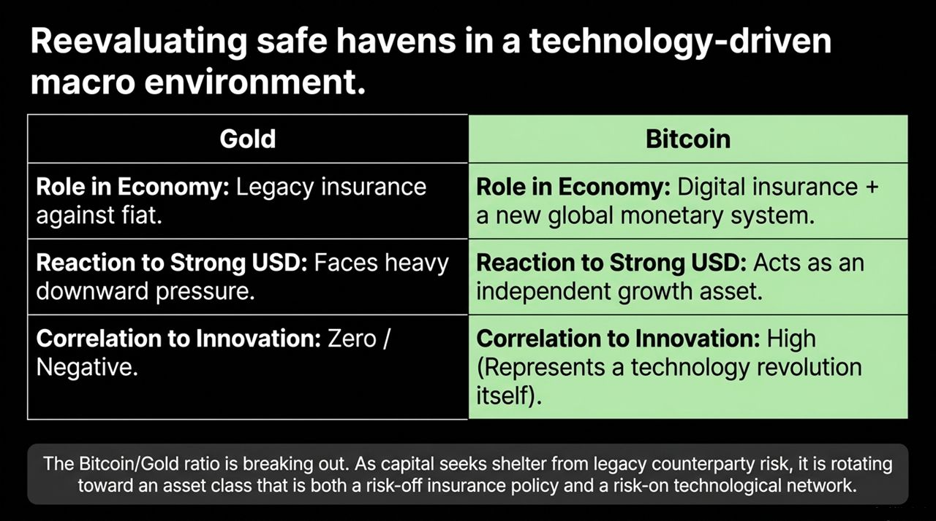
Notes:
Gold vs. Bitcoin:
Gold: Traditional fiat hedge; faces downward pressure during US Dollar strength; zero to negative correlation with technological productivity.
Bitcoin: Digital monetary system + tech network; independent growth asset; high correlation with innovation ecosystems.
The Bitcoin/Gold ratio is breaking out.
As counterparty risk grows in legacy sectors, capital is rotating toward Bitcoin as an asset that functions both as systemic risk-off insurance and risk-on participation in a monetary technology network.

Slide 15
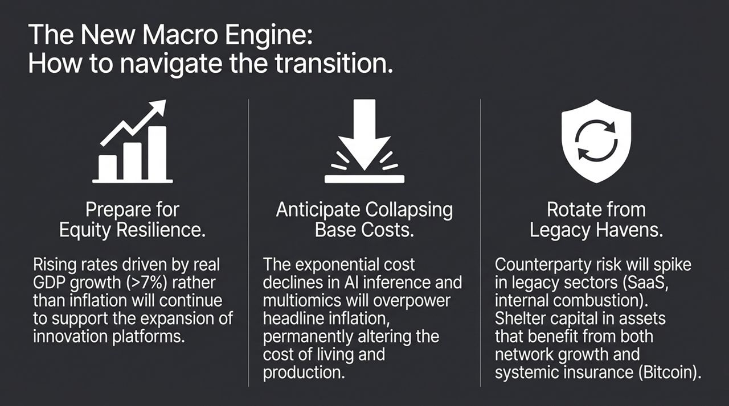
Notes:
1. Prepare for Equity Resilience: Understand that market gains during rising rate environments are driven by real GDP productivity (>7%), not runaway inflation.
2. Anticipate Collapsing Base Costs: Factor in 99.99% annual cost drops in AI compute and multiomics when modeling corporate margins and cost of living.
3. Rotate Away from Legacy Havens: Identify counterparty risks in legacy software, traditional auto, and fossil fuels. Pivot capital into technological networks like Bitcoin and leading innovation platforms.

Slide 16
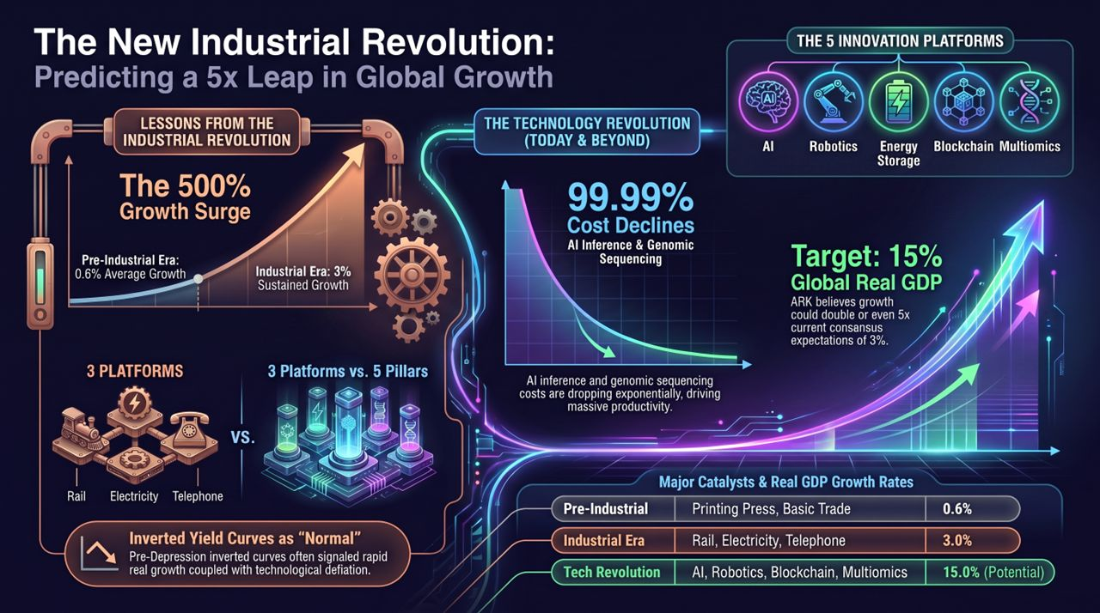
Notes:
Historical Benchmark: Pre-industrial growth was 0.6%. The Industrial Revolution unleashed a 500% surge to 3.0% sustained growth across Rail, Electricity, and Telephone.
Today's Setup: 5 converging platforms (AI, Robotics, Energy Storage, Blockchain, Multiomics) accompanied by unprecedented 99.99% cost drops in fundamental inputs.
While traditional consensus (IMF) expects a static 3.1% growth, ARK's analysis shows real global GDP growth could double or even reach 15% annually.
We are stepping out of 125 years of static consensus into a historic growth acceleration led by technology-driven productivity.

